Slide 1

G20 Government Spending Data
Sanhanat Satetasakdasiri
individual project
DATS 6401: Visualization of Complex

Slide 2
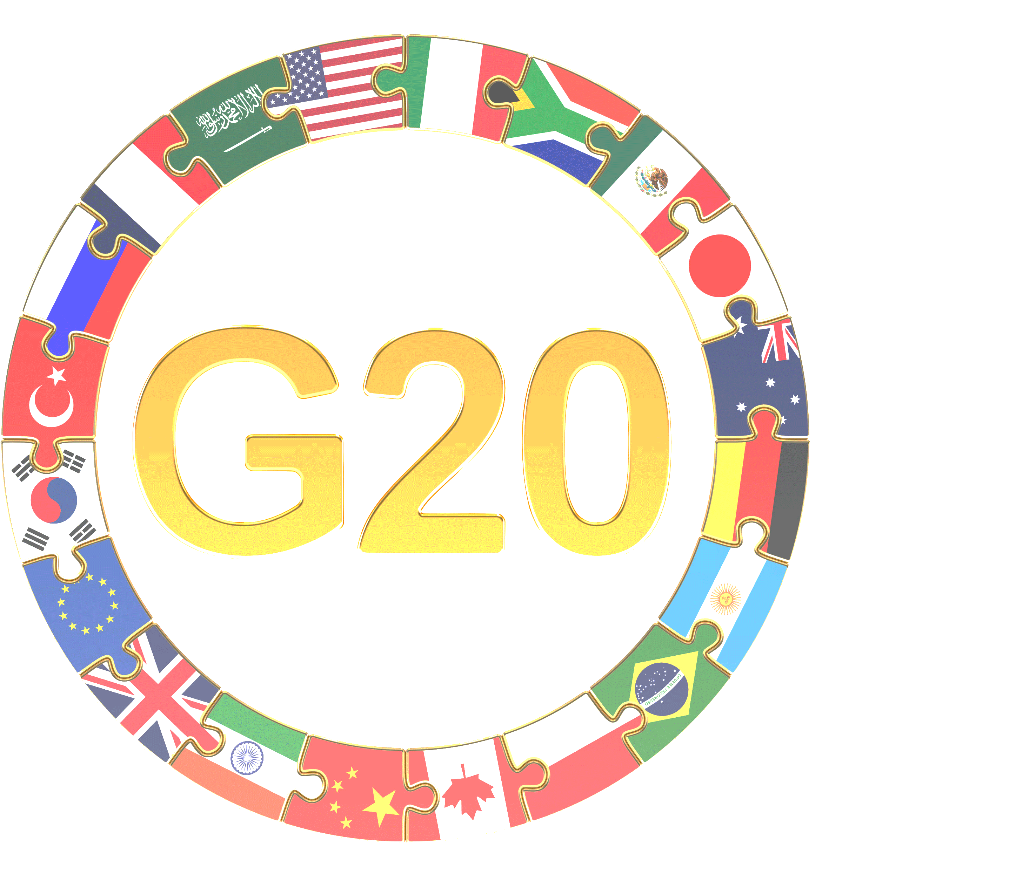
Overview
World Bank Data --> Yearly time series data from 2012 to 2016
Area of the project --> Picked Government spending (Education, Military, Healthcare) of G20 countries without European Union
Various charts --> Geo map, Column charts, Pie charts, Stacked Bar charts, Bar charts, Scatter plots, Line graph, and Trendline.

Slide 3
Outline
OVERVIEW
GDP map for G20 Countries in 2016
Column chart for government spending in each purpose in 2012-2016
Pie chart for government spending in each purpose in 2012-2016 (Average)
COMPARISON
Bar chart for shared each spending as % GDP in 2012-2016
Stacked bar chart for comparing spending in each purpose in 2012-2016 (Average)
Scatter chart for comparing spending per capita in each purpose to GDP per capita from 2012-2016 (Average)
TREND
Column chart for 10 Fastest growing countries in each spending purpose in fixed value 2012-2016
Line graph and bar chart 10 Fastest growing countries in each spending purpose in percentage 2012-2016
bar chart for average growth rate 2012-2016 of 10 Fastest growing countries
Scatter chart for the relationship between spending per capita in each purpose and GDP per capita for G20 countries

Slide 4
OVERVIEW
GDP of G20 Countries in 2016
Government spending in each purpose in 2012-2016

Slide 5
COMPARISON
Compare the spending data to that country’s GDP
Compare the education and health to the overall military spending of the country
Compare the per person educational spending to the per person GDP
Compare the per person healthcare spending to the per person GDP
Compare the per person military spending to the per person GDP

Slide 6
TREND
Fastest growing countries in healthcare and educational spending in fixed value and in percentage
Identify any interesting and useful relationships
and trends

Slide 7
Conclusion 1
The US is the G20's largest economy and spend the highest spending on education, military, and healthcare, among other countries.
Almost countries, except Saudi Arabia, had the largest proportional spending that was for healthcare, followed by education and military, respectively.
In term of % of GDP, South Africa and Brazil had the two highest spent on education. While, Saudi Arabia had the highest spent on military. For healthcare purpose, the US had the highest spent.
In term of per capita, Australia and US spent per person on education, higher than the others. While, Saudi Arabia was the highest military spending per capita. For healthcare, the US spent on the first list.

Slide 8
Conclusion 2
There was no general trend in fixed value and in percentage change of spending in all three purposes of each country over time.
The US always had the big change in spending between each year among other countries.
The US was the fastest growth rate in educational spending from 2012 to 2016
China was the fastest growth rate in military and healthcare spending from 2012 to 2016
There was positive relationship between spending per capita in each purpose and GDP per capita of G20 countries. This makes sense since higher average income resulted in more average spending.

Slide 9
About The tools
RStudio and Microsoft Excel were used to clean the data
HTML5, CSS, and JAVASCRIPT were used to work together
Adapted elements from W3 School, Google visualization chart , and other online sources
Adobe Photoshop CC 2019 was used to edit the images

Slide 10
THANK YOU

